Slide 1




A DOA and RSS-based Localization Radio System with a CPW-Fed Monopole Array Antenna at 5.8 GHz
2018 IEEE International Symposium on Antennas and Propagation and USNC-URSI Radio Science Meeting
8-13 July 2018 • Boston, Massachusetts
Authors:
Iñigo Cortés Vidal (icortesv@alumni.tecnun.es)
Fátima Villa Gónzalez (A903997@alumni.tecnun.es)
Álvaro Urain Echart (A904590@alumni.tecnun.es)
T
T
T

Slide 2
Index
Introduction
System Design
Stay in Boston
Conclusion
Future work

Slide 3
Index
Introduction
System Design
Stay in Boston
Conclusion
Future work

Slide 4
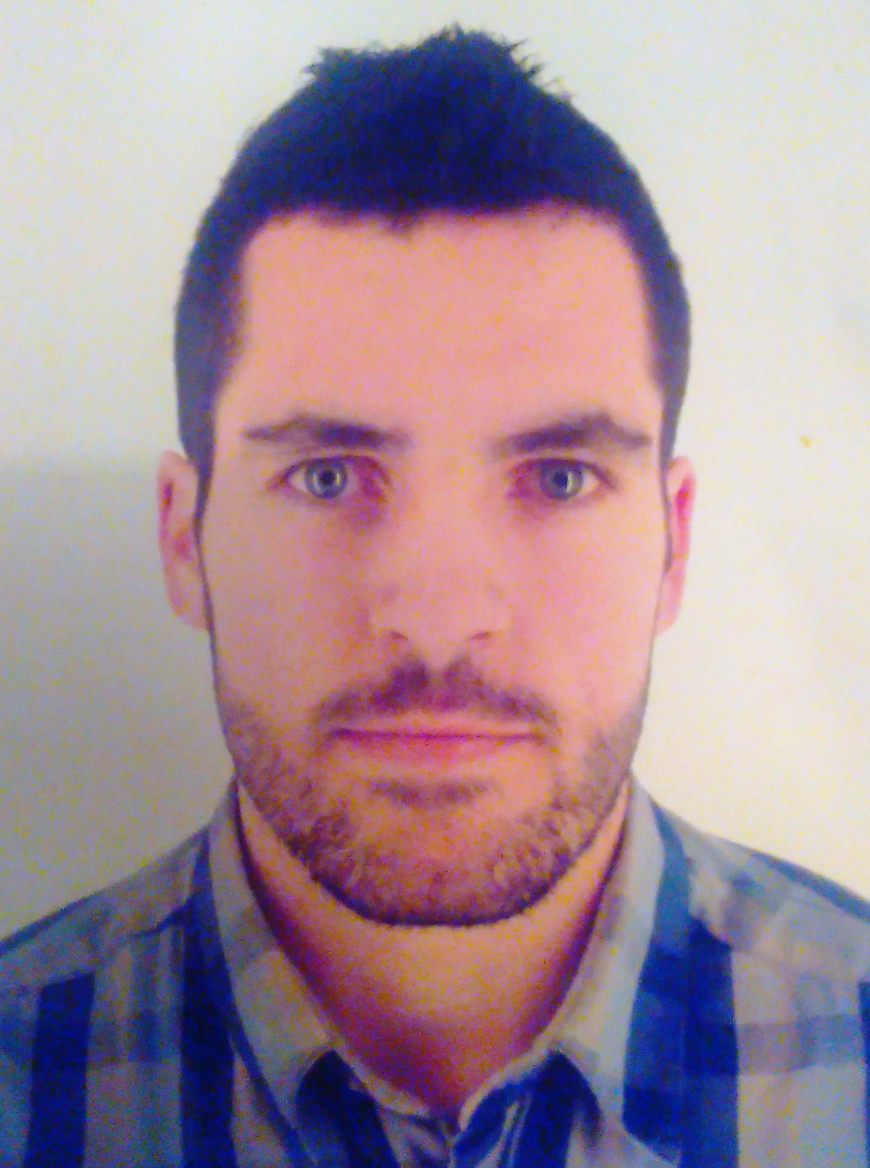
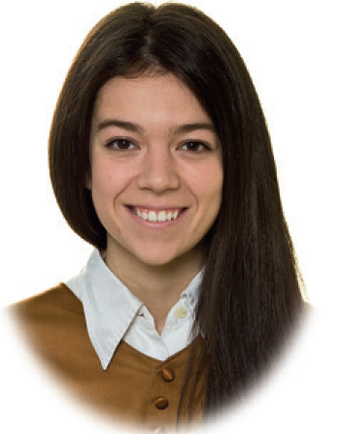
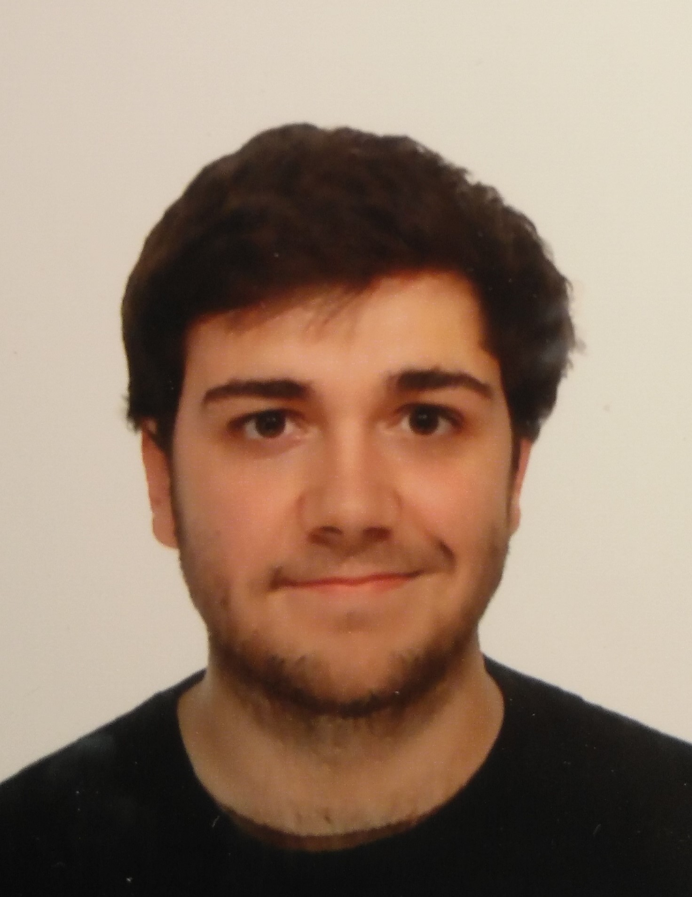
“TripleT” student team
T
T
T
Iñigo Cortés Vidal
Fátima Villa González
Álvaro Urain Echart
Graduated in Elec. Comm. Eng.
Master of Telecomm. Eng.
Research Assistant in Fhg IIS.
Graduated in Sys. Comm. Eng.
Master of Telecomm. Eng.
Undergraduate in
Elec. Comm. Eng.
Supervisor: Dr. Daniel Valderas

Slide 5
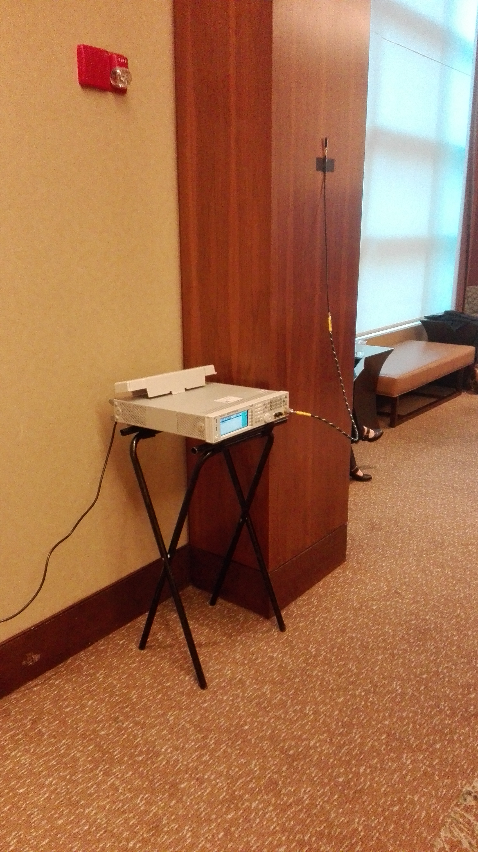
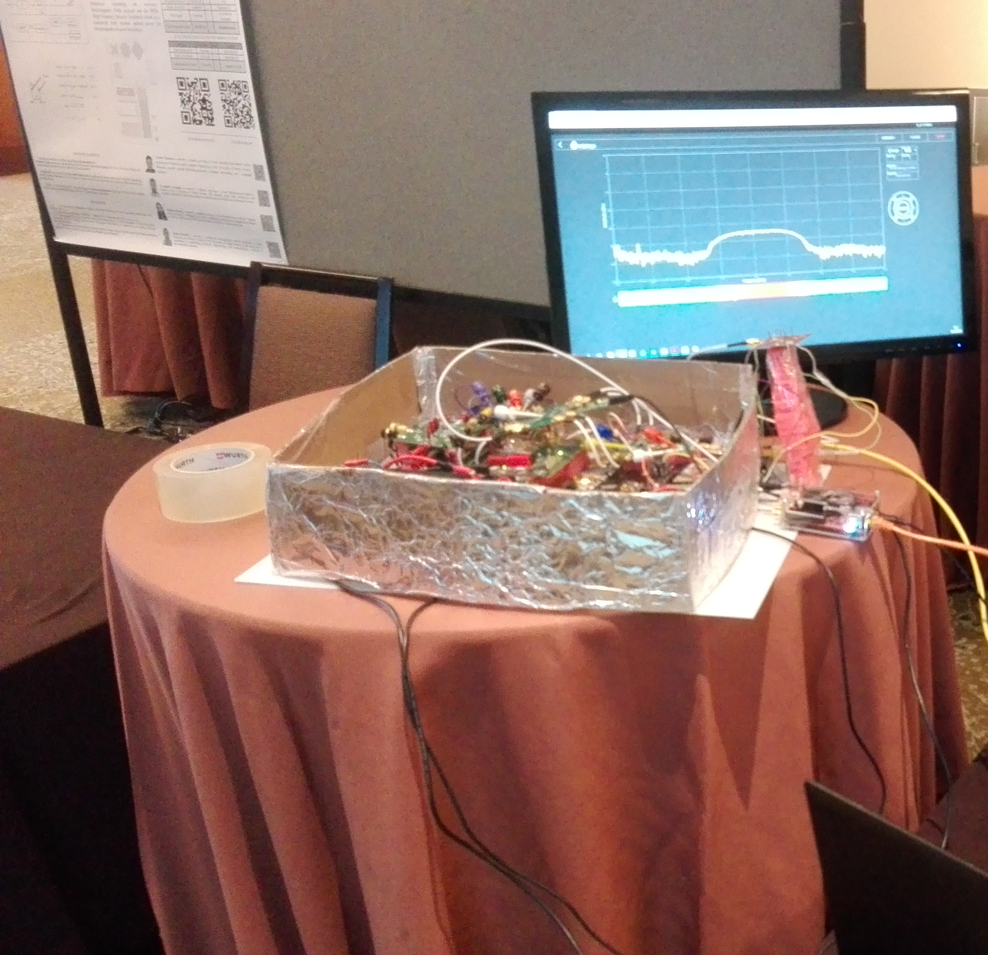
2018 IEEE AP-S Student Design Contest
Goal: Design and build a radio system to sound a radio channel in real time and accurately determine the location of a hidden transmitter.
Notes:
Is the 9th year of this Student Design Contest. In previous Contests there were 40-50 competitors but this year, because of the complexity of the challenge, there were only 14. And 6 of them went to the final.

Slide 6
Transmitter details
Center frequency: 5GHz ISM Band (5.8 GHz)
Transmitted data: PN sequence by a 9th order LFSR
Data rate: 1Mchip/s
Modulation: BPSK
RRC filter (roll-off = 0.5)
Single monopole antenna
EIRP will not exceed the ISM limitations: 36 dBm EIRP

Slide 7
Index
Introduction
System Design
Stay in Boston
Conclusion
Future work

Slide 8
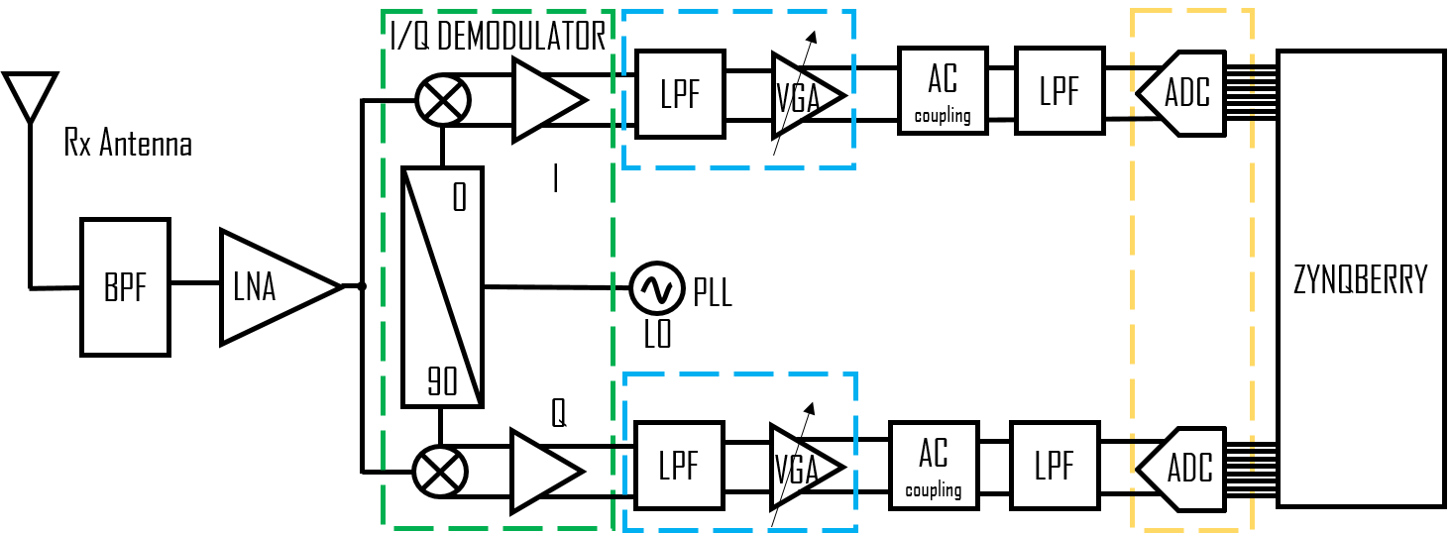
System workflow
Data
Acquisition
System
+
DSP
Array
Antenna
Front End

Slide 9
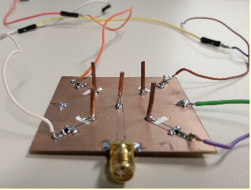
CPW-fed monopole array antenna
Configurable from Zynqberry
Resolution: 90⁰ (4 directivities)
1 driven element
4 parasitic elements
No ground plane in the bottom
1 Diode for each parasitic element
Size: 50mm x 50mm

Slide 10
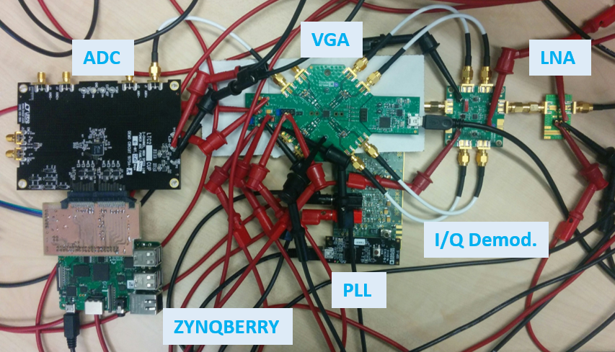
Front-End
Main Elements
Notes:
fif = 2 MHz
fs = 12MSPS
Dual Data Rate
Resolution: 16 bits

Slide 11
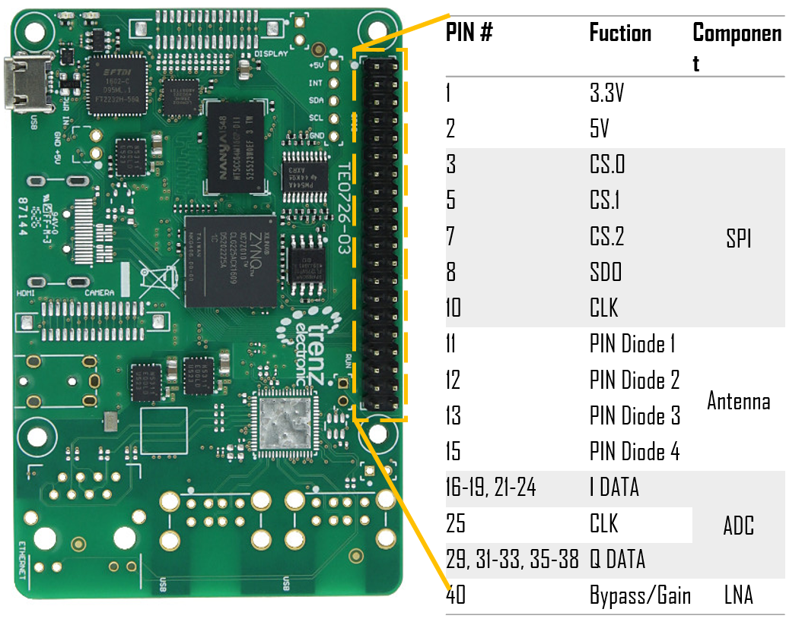
Zynqberry

Slide 12
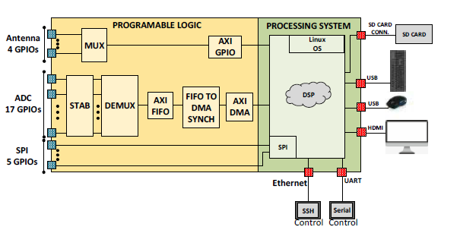
Zynqberry

Slide 13
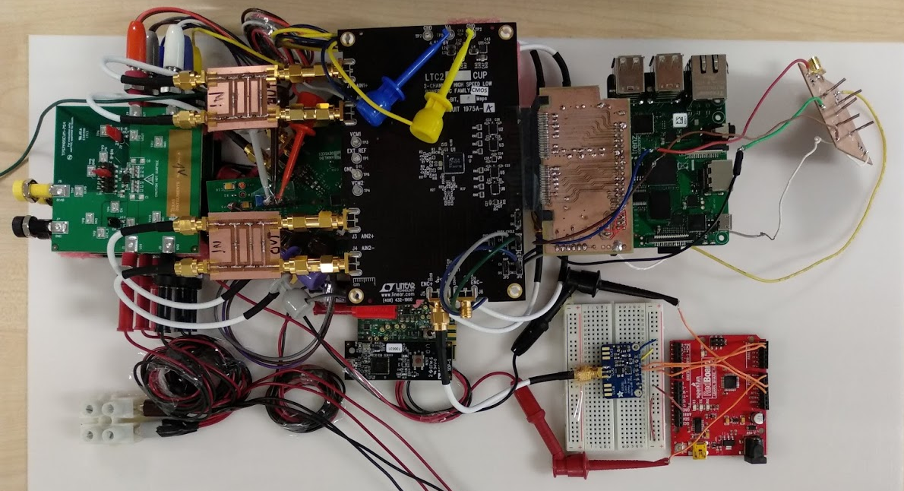
First complete structure

Slide 14
Index
Introduction
System Design
Stay in Boston
Conclusion
Future work

Slide 15
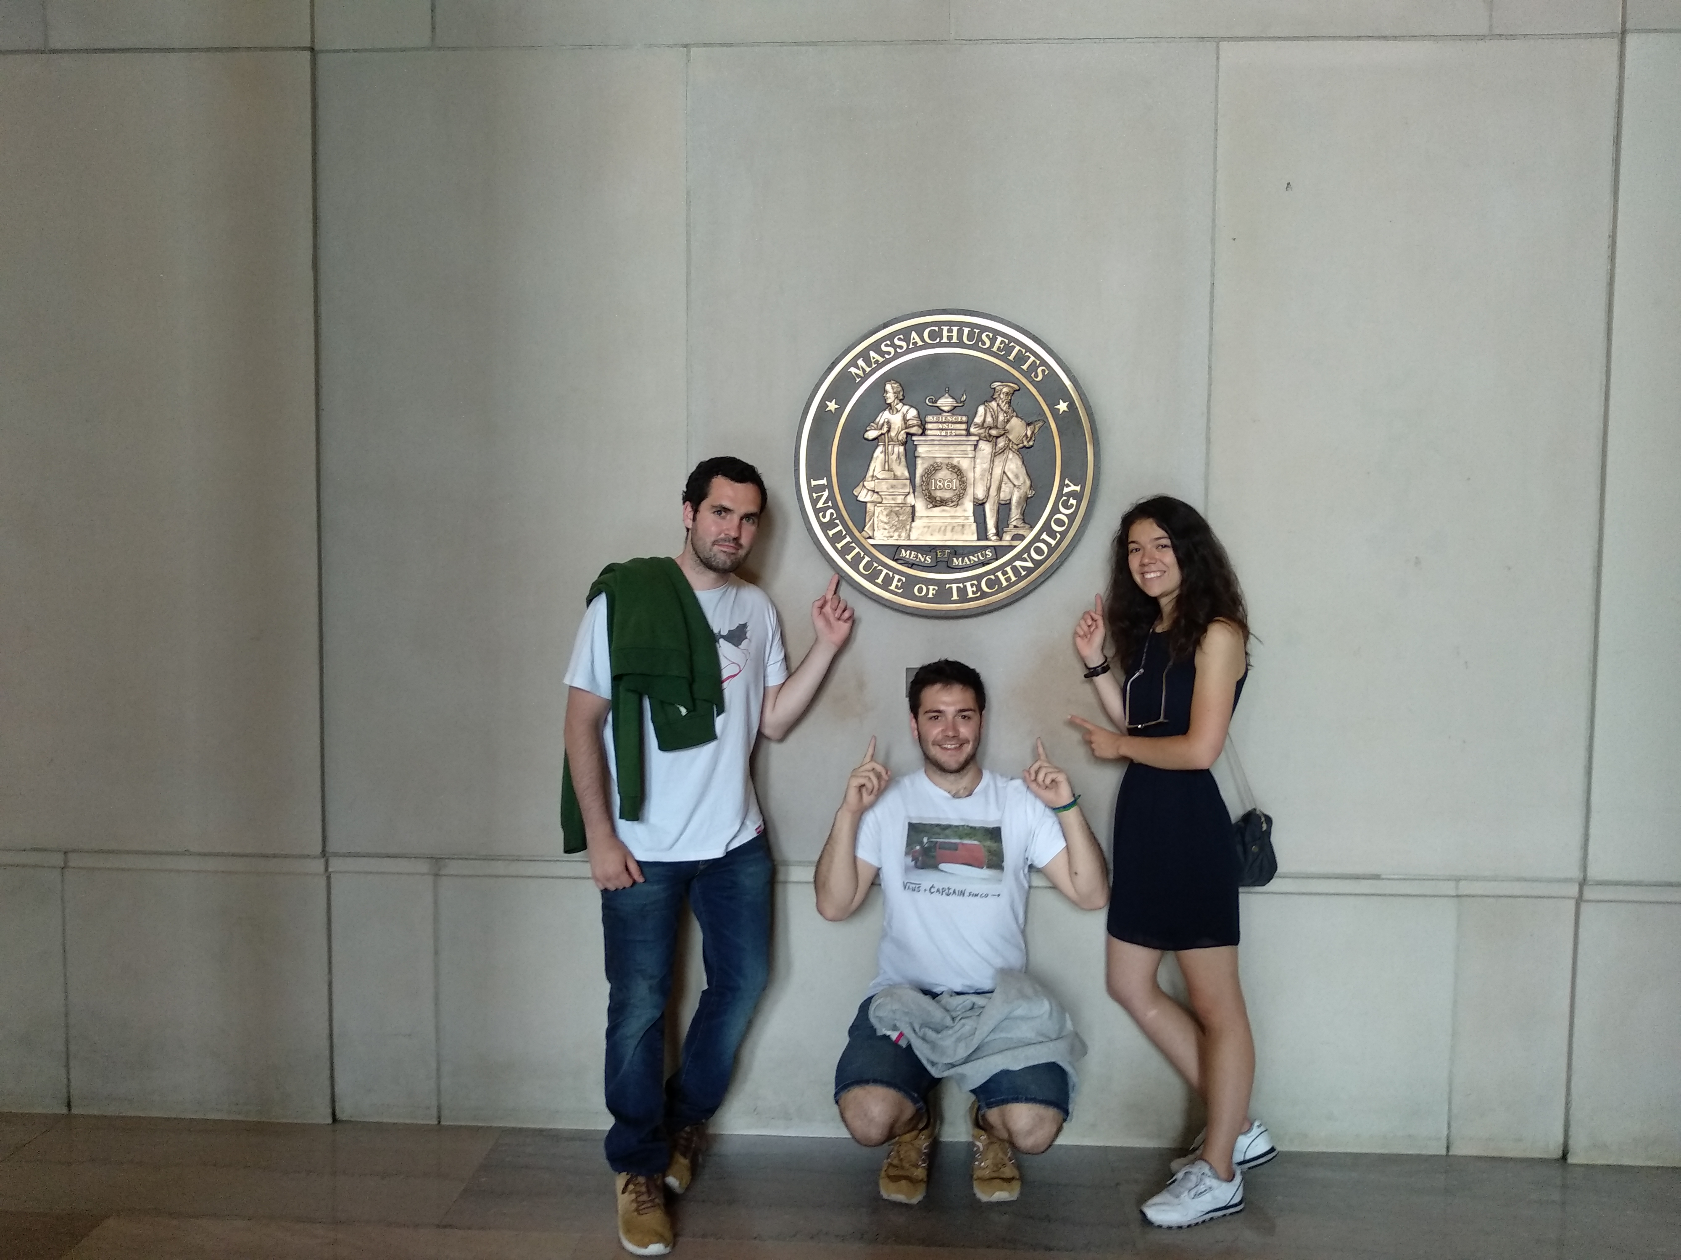
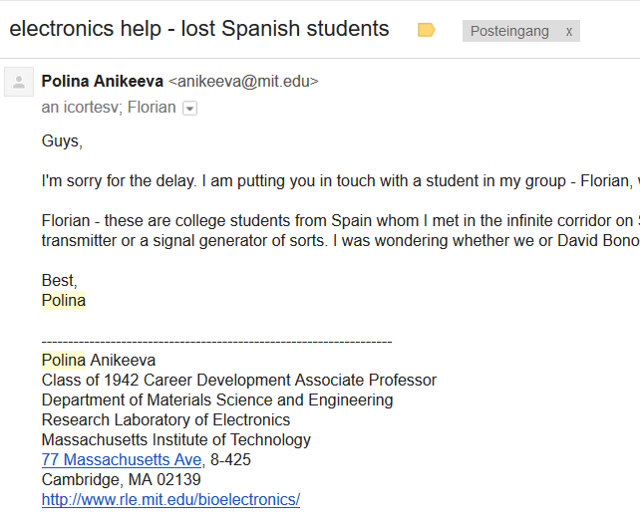
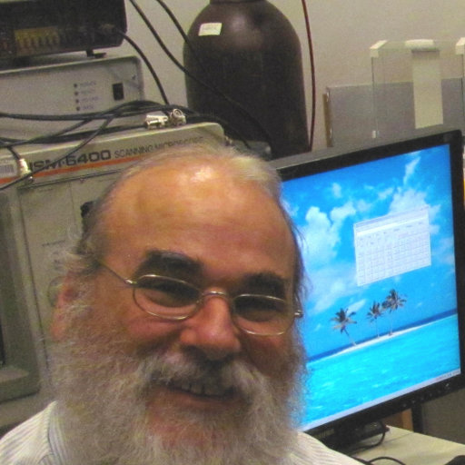
MIT
David Bono
Instructor LAB Manager DMSE UGTL at MIT

Slide 16
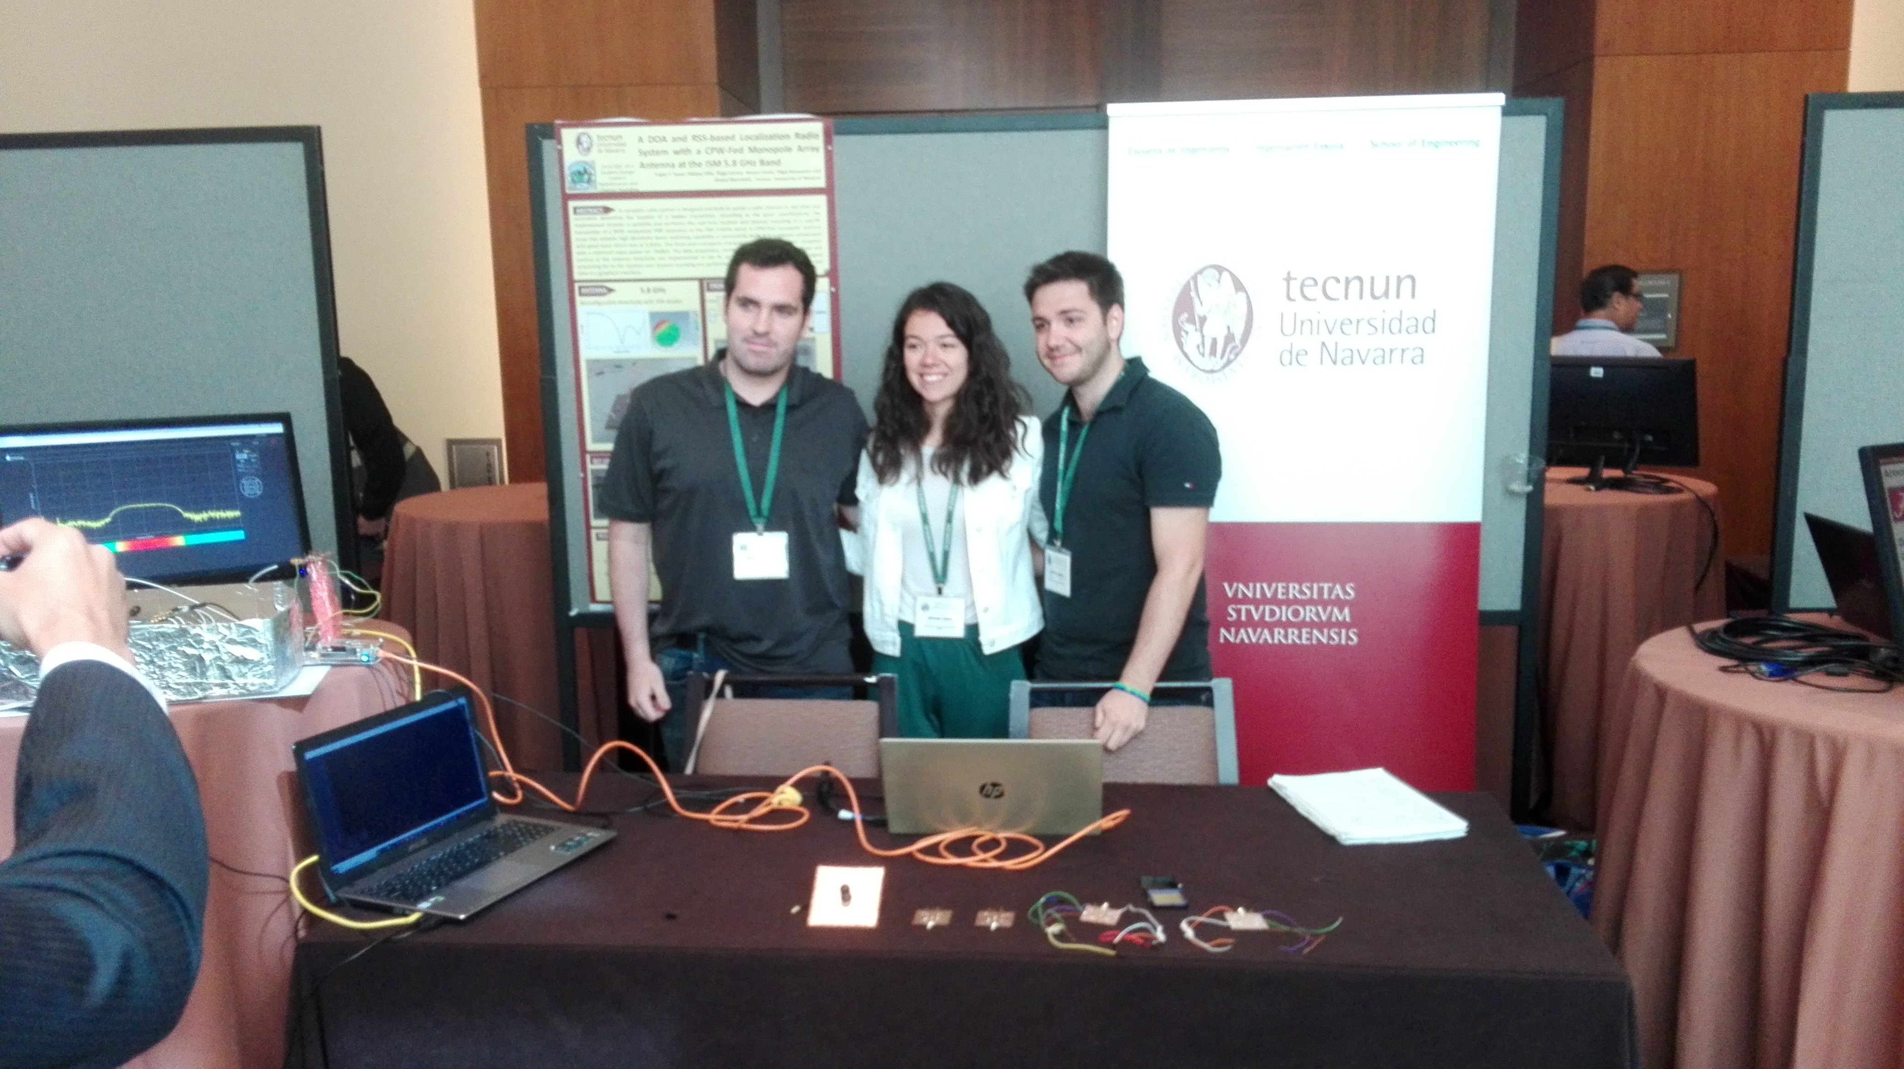
AP-S Student Design Contest
Set-up and judging time

Slide 17
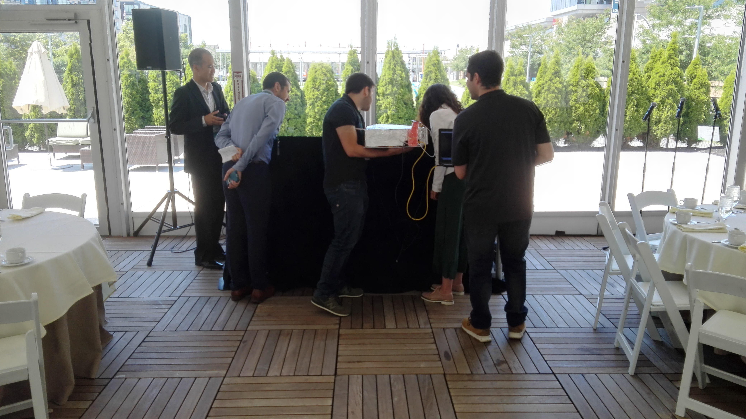
AP-S Student Design Contest
Fox hunt

Slide 18
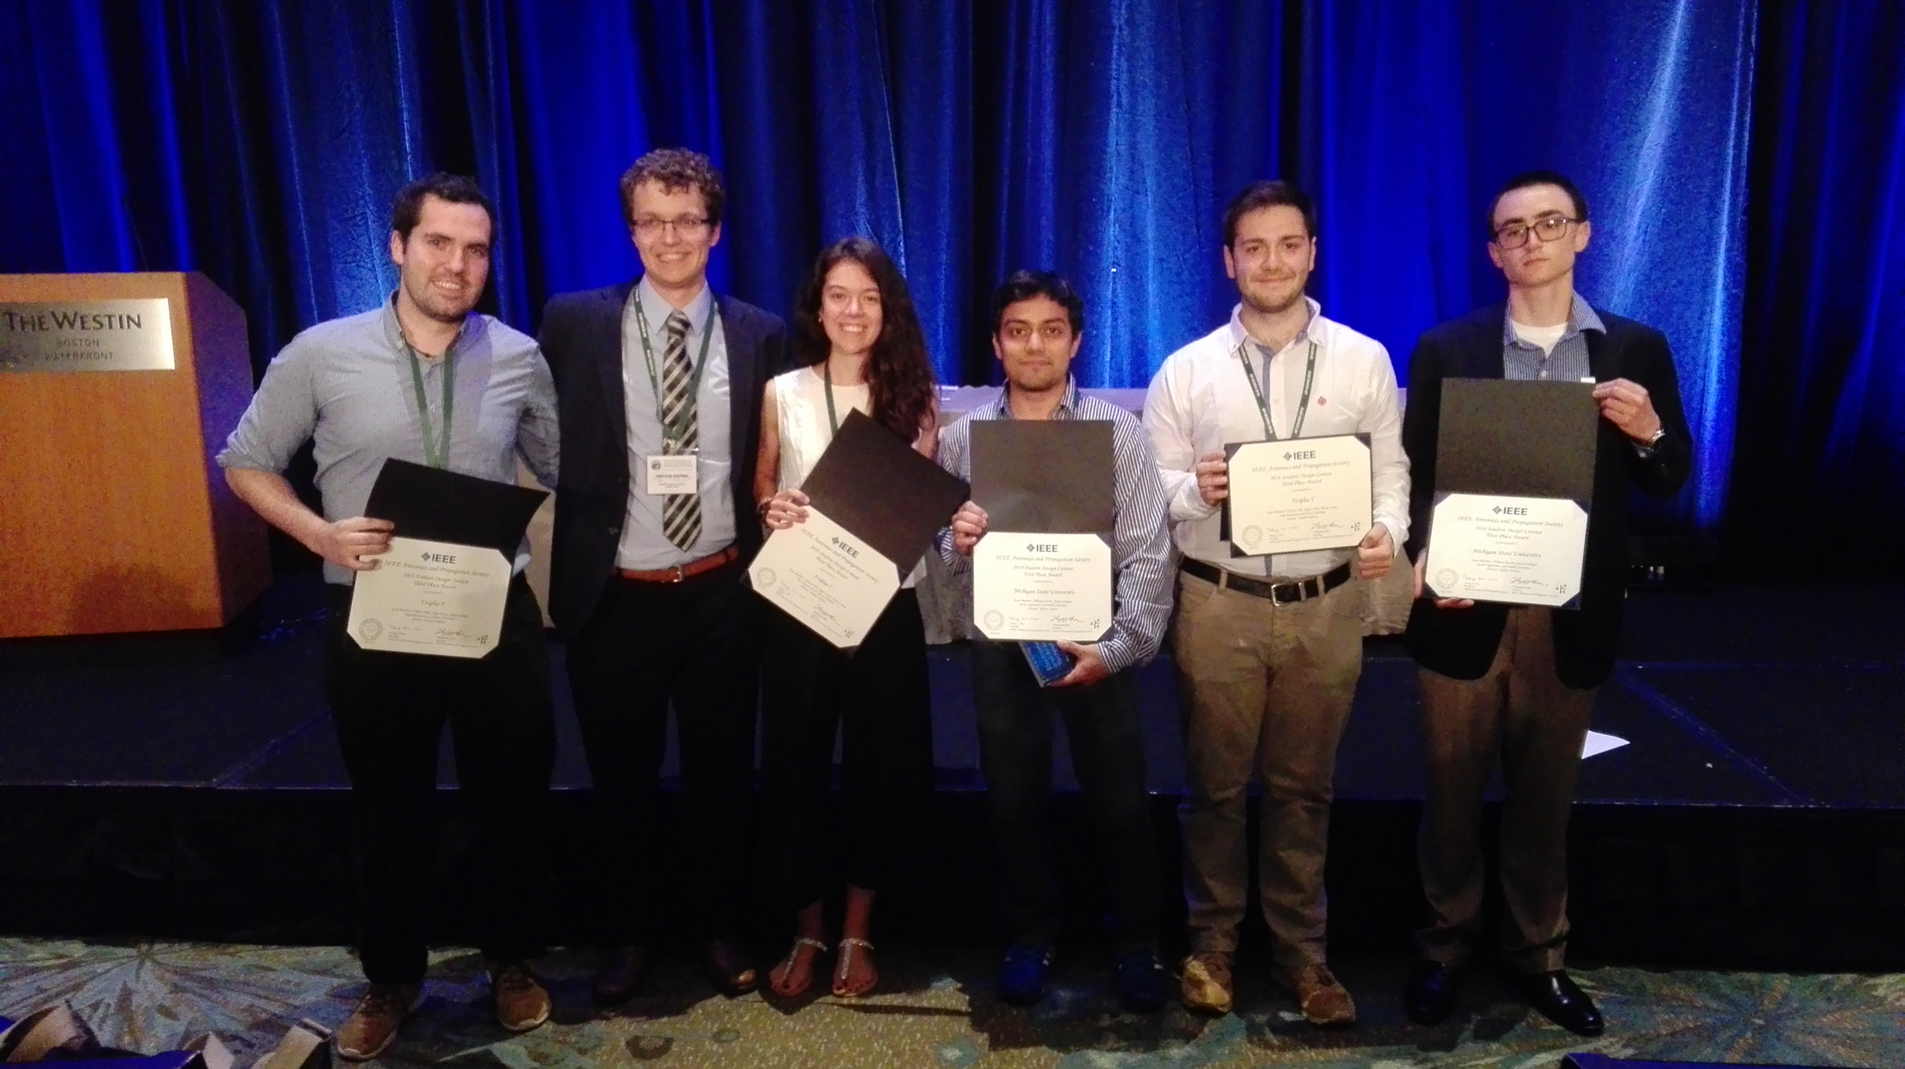
AP-S Student Design Contest
Third Place Award

Slide 19
Index
Introduction
System Design
Stay in Boston
Conclusion
Future work

Slide 20

Conclusion
Didactic-purpose receiver made from “scratch”
Original novel array antenna design
Correct implementation of the acquisition system
Possibility of working without a laptop
Remote team work experience
Enriched knowledge from the rest of the teams

Slide 21
Index
Introduction
System Design
Stay in Boston
Conclusion
Future work

Slide 22
Future work
Antenna Improvement
Increase the ground plane → Better S11
Ground plane in the bottom → Better S11
More parasitic elements → Better resolution
Front-End improvement
Minimize the Front End → More portable, reduction of EMI
Modify Front-End to received an increased bandwidth (100 MHz)
Zynqberry improvement
Downconversion and correlation implemented in FPGA.
Create an interface → Receiver without a lap-top

Slide 23
Suggestions
Important parameters
Frequency band
Antenna Resolution
Size
Security
Topics
Array Antenna for satellite communication. (L1, L2, E5a, E5b… bands)
Indoor Communication
Autonomous car
Industry 4.0 : Mapping

Slide 24
A DOA and RSS-based Localization Radio System with a CPW-Fed Monopole Array Antenna at 5.8 GHz
2018 IEEE International Symposium on Antennas and Propagation and USNC-URSI Radio Science Meeting
8-13 July 2018 • Boston, Massachusetts
Authors:
Iñigo Cortés Vidal (icortesv@alumni.tecnun.es)
Fátima Villa Gónzalez (A903997@alumni.tecnun.es)
Álvaro Urain Echart (A904590@alumni.tecnun.es)
T
T
T

Slide 25
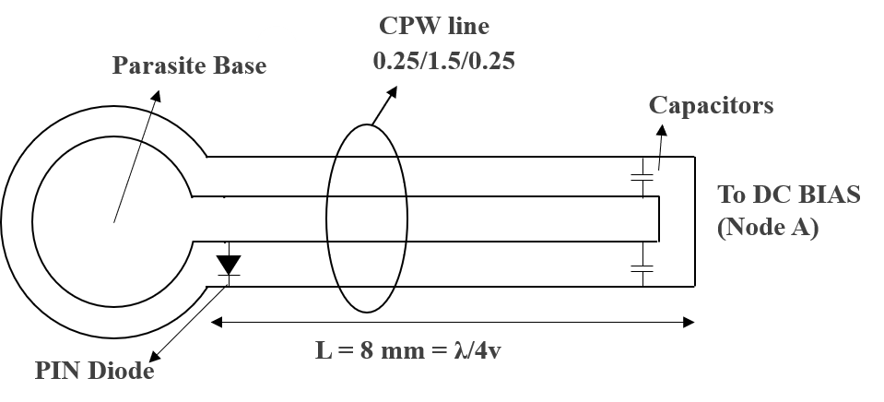
CPW-fed monopole array antenna
Transmission line of each parasitic element
PIN diode fed → Reflector
PIN diode not fed → Parasitic Element

Slide 26
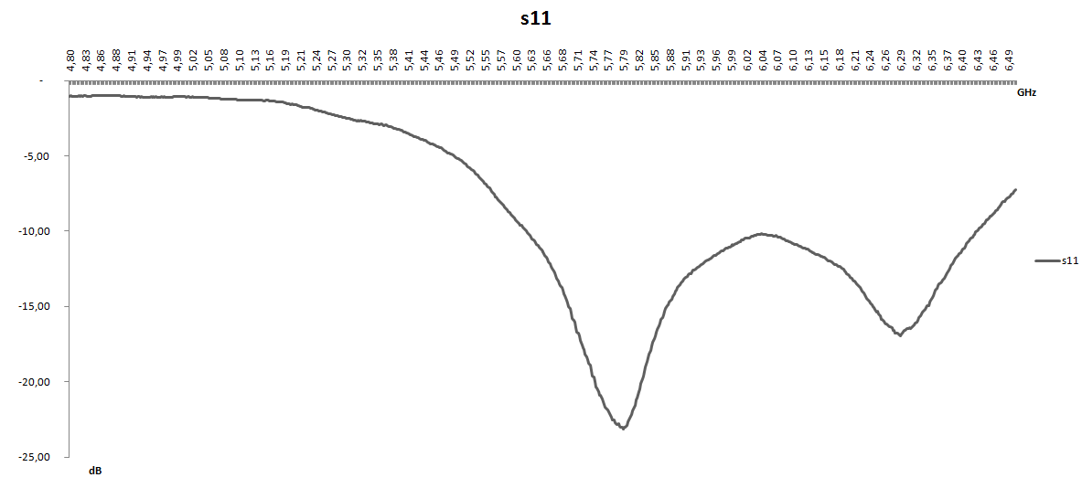
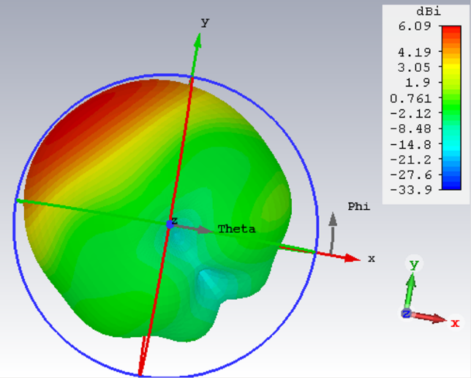
CPW-fed monopole array antenna
Radiation pattern and S11 for one directivity

Slide 27
DSP workflow

Slide 28

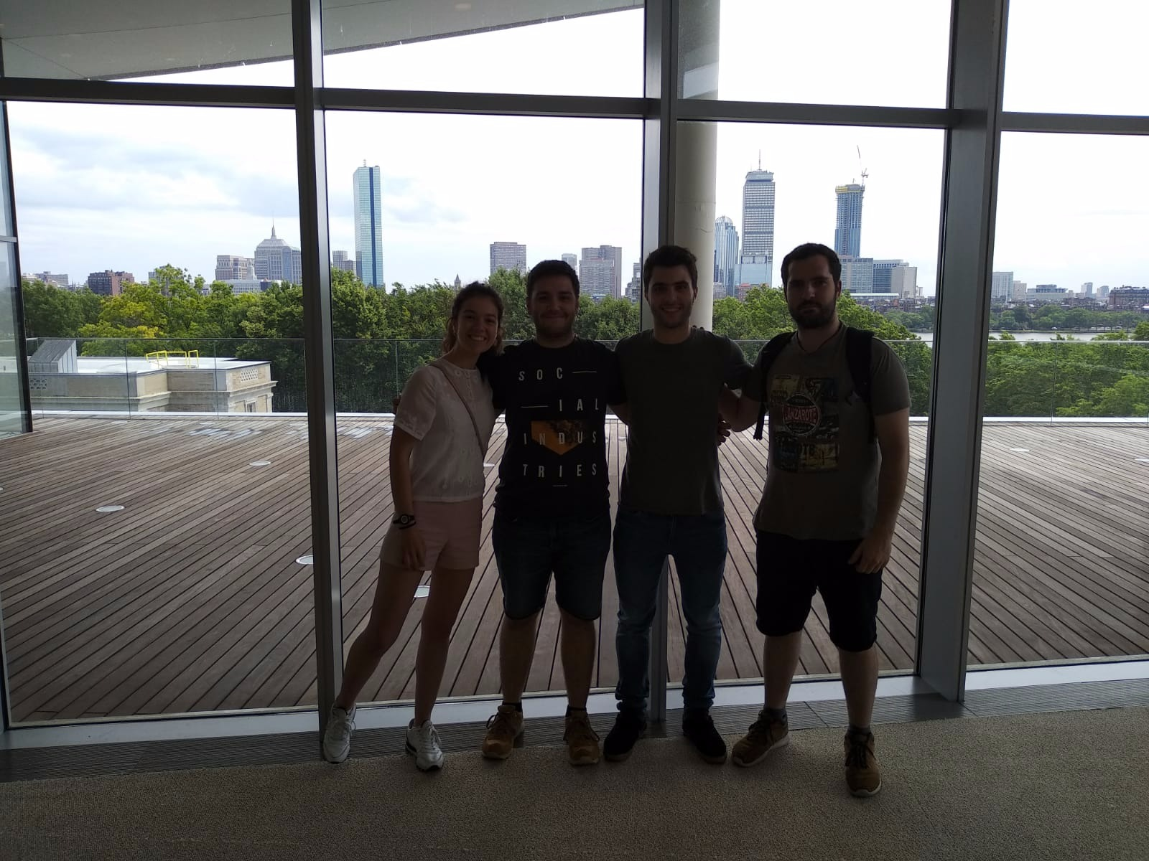
MIT Media Lab

Slide 29
T
T
T
T
T
T

